Slide 1
Dorset Renewable Industries Pty. Ltd.
Community Update
29 October 2014

Slide 2
Dorset
Renewable Industries Pty. Ltd.
ABN 84 163 324 034
“Dorset Renewable Industries Pty Ltd is a community focused enterprise, aimed at developing new industries for the Dorset region of North East Tasmania, which utilize the region’s renewable resources in ways which makes the community more resilient and improves the environment.”

Slide 3
Who we are
We developed as a Community group well over two years ago from within the Dorset municipality in response to the economic situation in the region.
We are one of the focus points for the community’s desire to help itself.
Our group consists of:
  Chairman David Hamilton who has extensive experience in environmental health and safety in the oil industry and lives at Lilydale.
  Ken & Karen Hall, Michael Brill, Dale Jessup representing community interests, forestry, saw milling and forest products industries, all from the Scottsdale area.
  Wendy Mitchell with environmental management and economic development and small business experience, who lives in Launceston.
  Local identity, John Beattie who has many years of operational experience in food processing .
  Assisted by other North Easterners, Alan Davenport, Heath Blair, Peter Bird

Slide 4
Our Broad Objectives
Establish a new forestry-related enterprise in Dorset to make the best use of existing resources.
Deliver positive social, economic and environmental outcomes to the Dorset community.
Use feedstocks that can be produced on an ongoing and reliable basis and give fair payment for them.
Make innovation an important component of the enterprise.
Collaborate and share knowledge and expertise.
Create long term jobs and develop skills.

Slide 5
Wendy Mitchell
Tonight’s Program

Slide 6
Program
Ling Siding: DRI’s vision for the site, grant application, and next steps | Wendy Mitchell
Ling Siding refurbishment project | Dale Jessup
Volunteers, assistance and staying involved | Ken Hall
Establishing the Integrated Timber Processing Hub | Michael Brill
Ethanol Plant update | David Hamilton
Ethanol Plant resource assessment | Jeremy Wilson
Ethanol Plant prefeasibility study | Martin Rees
Funding new timber businesses | David Hamilton
Questions | Panel

Slide 7
Wendy Mitchell
Grant Application — the start of our vision becoming reality

Slide 8
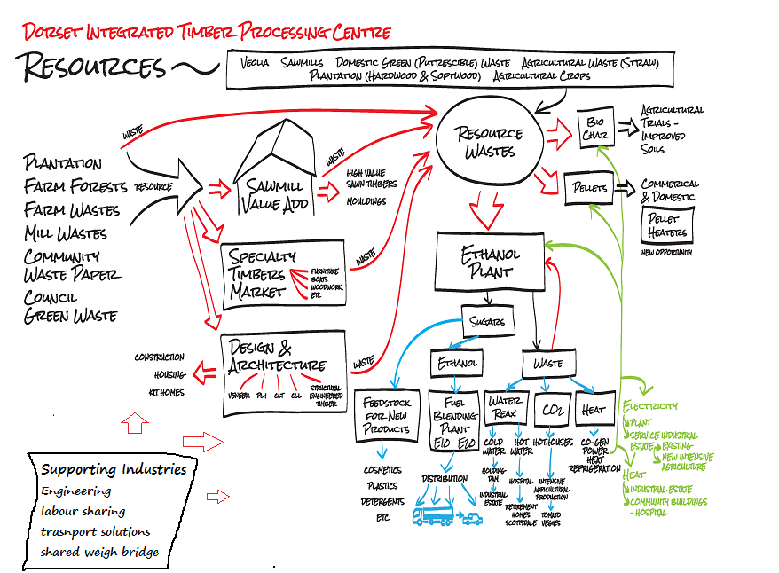

Slide 9
Grant Timeline
June 2013 | DRI applied for two grants under the Tasmanian Forestry Agreement economic diversification process: $2.8M for Ling Siding and $1.6M for the ethanol plant
July 2013 | DRI attempts to prevent Korda Mentha from further dismembering of the Ling Siding site.
25 July 2013 | Prime Minister Kevin Rudd announced that DRI’s application for $2.8M to purchase and refurbish Ling Siding was successful, subject to a “value for money” test.
August 2013 | Korda Mentha starts sale process for Ling Siding, DRI places indicative offer, dependant on grant funding.
Sept 2013 | DRI submits final bid for Ling Siding, together with letter from Tony Abbott promising not to cut the grant if elected.
Sept 2013 | Korda Mentha rejects DRI’s offer because of funding uncertainty
Oct 2013 | RNG Property Developments agree to sell most of the industrial land at Ling Siding to DRI, subject to grant funding
Dec 2013 | Details of “value for money test” for the grant released
June 2014 | DRI submits over 400 pages of documentation for value for money test
25 Aug 2014 | Assistant Minister for Infrastructure writes to DRI confirming grant, but subject to negotiation of a grant deed (draft grant deed is 46 pages).

Slide 10
About our Grant
Federal Grant - $2.8 Million plus GST
Strong oversight and management by the Federal Government
Can only be used for the refurbishment of the Ling Site and prepare the site for a Timber Integrated Processing Hub
Funding is tied to milestones that must be completed before we can access further funds
Cannot be used to secure or help set up new businesses
Cannot be used for any other purpose than refurbishment
What does that mean?
The site will be ready and then it’s up to the Community, private enterprise, state government, DRI, or a Community Cooperative to encourage, develop and ultimately to establish new enterprises at this site.

Slide 11
Summary
DRI Committee needs to stay focused on the proper acquittal of $2.8 million dollars.
We need to ensure that the refurbishment funds are spent in accordance with the DEED.
That the site is ready and able to receive timber businesses that can mutually benefit by being on such a collaborative site.
That all this work culminates in opportunities, skills, work, employment and increased economic hope and activity in the North East Region.

Slide 12
Dale Jessup
Ling Siding Refurbishment

Slide 13
Ling Siding Site Refurbishment
Current Condition of the Site

Slide 14
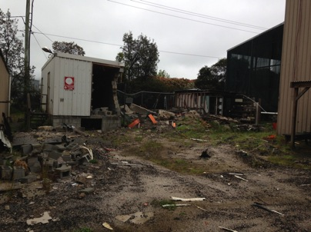
Previous Transformer Yard

Slide 15
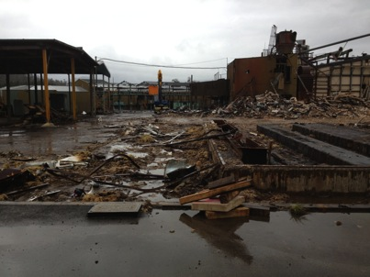
Kiln and Boiler Area

Slide 16
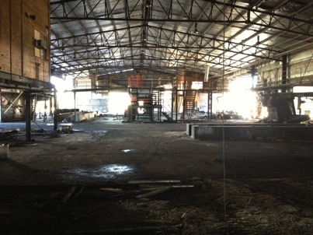
Inside Sawmill Building

Slide 17
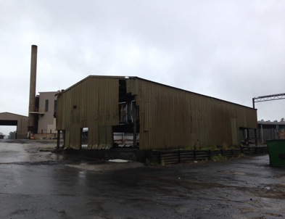
Condition of Buildings

Slide 18
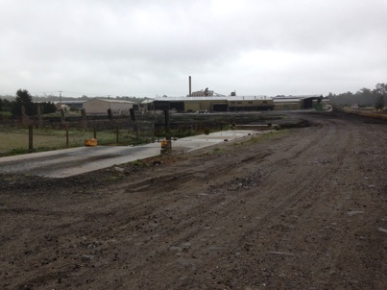
Weighbridge Foundation

Slide 19
Ling Siding Site Refurbishment
Major Project Components Consist of:
  Restoration of power to the site
  Making good all buildings
  Restoration of communication & IT systems
  Restoration of fire water supply
  Restoration of potable water & effluent systems
  Installation of a public weighbridge
  Restoration of site fencing & erection of new fencing
  Re-sealing 27,000 m² hardstand area.

Slide 20
Ling Siding Site Refurbishment
Project Management:
  Project manager to be engaged
  Safety systems to be established
  Scope of works to be finalised
  Contracts for each project component to be developed
  Utility providers to be engaged
  Contractors selected and work commences.

Slide 21
Ling Siding Site Refurbishment
Key Focus Areas of Project
  Occupational health and safety of all people involved in the project
  Management of environmental issues specific to the site
  Maximise value of grant funding
  Use of local contractors to minimise economic leakage of the funding
  Consideration of rail trail traversing site.

Slide 22
Ling Siding Site Refurbishment
What the Grant Does Not Fund
  Refurbishment of the 20 MW boiler
  Funding to attract business to the site
  Replacing any buildings that have been removed
  Any component of the ethanol plant project.

Slide 23
Ling Siding Site Refurbishment
The Outcome Will Be An Industrial Site That:
  Has separately metered power to each area
  Is connected to the internet
  Has water and effluent systems
  Is secure
  Has good road surfaces
  Has weighbridge capability
  Has scope for further expansion
  Will provide ongoing opportunities for our community.

Slide 24
Ken Hall
Volunteers, assistance and staying involved

Slide 25
Michael Brill
Establishing The Hub.

Slide 26
Future Opportunities
The opportunity taken
  Ling Siding will again be available as a site where people are employed processing timber
What the grant funding achieves
  Ling Siding as infrastructure
Hub concept offers increased resilience through:
  Businesses working together, sharing common resources and services
  Ideally, no waste – the maximum value is achieved from every log, regardless of its quality
  Many baskets for our economic eggs.
Renewable relationship with timber and industry

Slide 27
Potential timber industries
Timber preservation
Timber posts
Log peeling for veneer
Cross-laminated timber
Orientated strand
Pellets
Ethanol
Saw milling
Associated enterprises
  Engineering
  Enterprises requiring steam raised by burning wood waste
  Soil conditioning – composting and/or biochar

Slide 28
David Hamilton
Ethanol Plant Update

Slide 29
Overview
Ethtec are developing a process for converting woody material to ethanol
  One of several “cellulosic ethanol” processes being developed world-wide.
Ethtec’s approach suits smaller plants and can use a range of feedstocks.
DRI is considering the opportunity of a plant using Ethtec’s technology:
  To be located at Ling Siding
  Producing 30 million litres of ethanol per year
  Using 150,000 tonnes of feedstock per year, some of it waste, the rest logs from local tree growers.

Slide 30
Advantages of possible
Ethanol Plant
Provide local employment and use local support services.
Pay local suppliers for feedstock
Ethanol product a renewable liquid fuel:
  Able to be blended into gasoline and diesel
  Some engines can use 100% ethanol
  Reduce reliance on fossil fuels
Reduce reliance on petroleum imported into Tasmania
  Improved security of supply
  Reduces economic leakage
Possibility of some non-fuel products as well:
  Ethanol as a solvent
  Sugars for bio-plastics

Slide 31
Status of ethanol plant
Tasmanian Government (Dept. of State Growth) paid for a resource study by Esk Mapping and GIS
Tasmanian Government and Dorset Council jointly funded a prefeasibility study which was performed by KPMG
Ethtec are continuing technology development
  Pilot Plant at Harwood in NSW has successfully completed Phases 1 and 2
  Preliminary work for Phase 3 well underway
  DRI has a current Memorandum of Understanding with Ethtec giving us access to their technology.

Slide 32
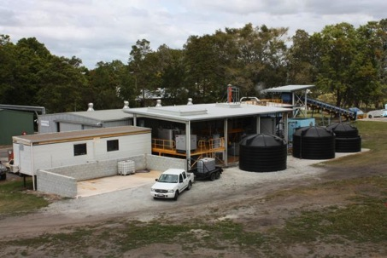
Ethtec Pilot Plant
Phase 1 and Phase 2

Slide 33
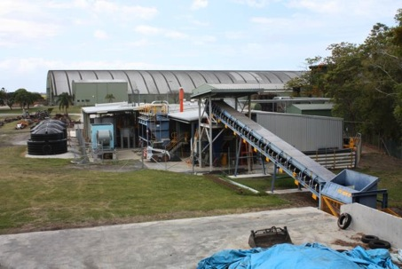
Ethtec Pilot Plant
Phase 1 and Phase 2

Slide 34
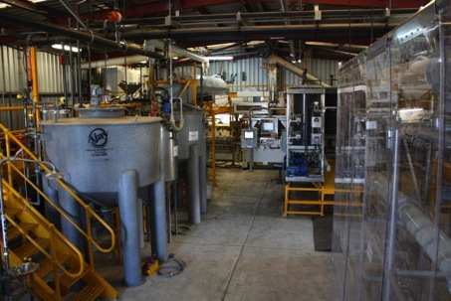
Ethtec Pilot Plant
Phase 1 and Phase 2

Slide 35
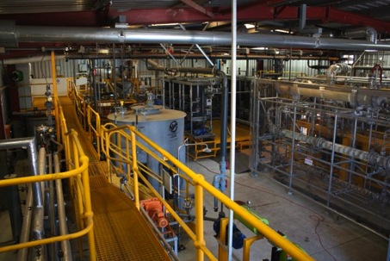
Ethtec Pilot Plant
Phase 1 and Phase 2

Slide 36
Next Steps
There are many steps still before us if the ethanol plant opportunity is to become a reality, such as:
  Ethtec need to successfully complete their pilot plant project and decide that the process is commercially feasible.
  DRI or the cooperative will need to negotiate an agreement with Ethtec to have access to detailed information about the plant and process (payment is likely to be required).
  There will need to be a range of engineering and environmental studies and a final plant design developed.
  Set up arrangements to buy feedstocks and sell the products.
  A formal, detailed feasibility study would be required.
  If everything looks OK then money would need to be raised/borrowed to build the plant and Government approvals obtained.

Slide 37
Jeremy Wilson, Esk Mapping and GIS
Resource Assessment

Slide 38
David Hamilton
Funding

Slide 39
Funding
Establishing any new business requires money.
Money will need to be raised to continue to develop the ethanol project.
If the Dorset community wants to establish a new enterprise, then the community will need to contribute funds to help make that happen.
The usual way for people to contribute to establishing a new enterprise is to buy shares in it:
  A way for the community to invest in itself
  A way for profits to be distributed to investors in the form of dividends.

Slide 40
Cooperative
DRI has considered KPMG’s advice about a suitable corporate structure that will enable:
  Control of enterprises to remain in the community
  Funds to be raised from members of the community at reasonable cost
DRI has decided that it will seek to start a cooperative, with the objectives of:
  Looking for timber-related opportunities (not just the ethanol plant) that would provide local employment and local economic development.
  Getting wider community involvement in developing opportunities.
We expect to kick off the process for starting a cooperative sometime next year
  After the Tasmanian legislation regulating cooperatives has been upgraded to a new national model.

Slide 41
Conclusions
As a community we need to take charge of our own destiny.
The DRI team have worked very hard and have achieved a lot since our previous community update.
There are many opportunities in the wood, wood products and energy from wood area.
The Ling Siding site gives us an excellent place to start the rebuilding:
  Need locally owned businesses
  Need a range of products, processes and enterprises to make the new timber economy as resilient as possible
A cooperative is the ideal structure for the community to use to build a better future.

Slide 42
Questions?
Thank you

